Slide 1
Neurograph Project
David Jiashu Wu

Slide 2
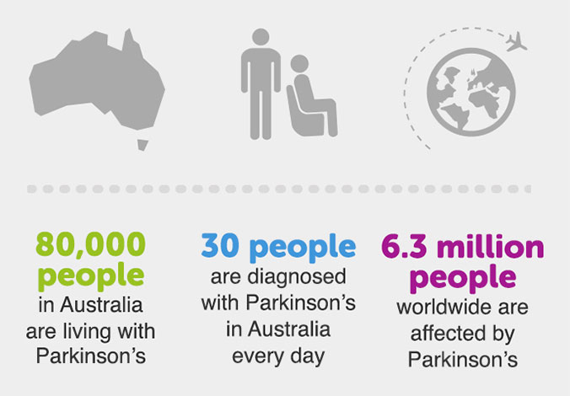
Facts about Parkinson’s Disease in Australia
Image resource reference: http://parkinsons-qld.org.au/wp-content/uploads/2015/07/did-you-know.jpg

Slide 3
What this project is about?
The name
tells the answer
Neuro
Graph
Detect Parkinson’s Disease
(Neurology)
By studying drawing patterns

Slide 4
What this project is about?
Neurograph Project:
Detect the Parkinson’s Disease by studying people’s drawing pattern.

Slide 5
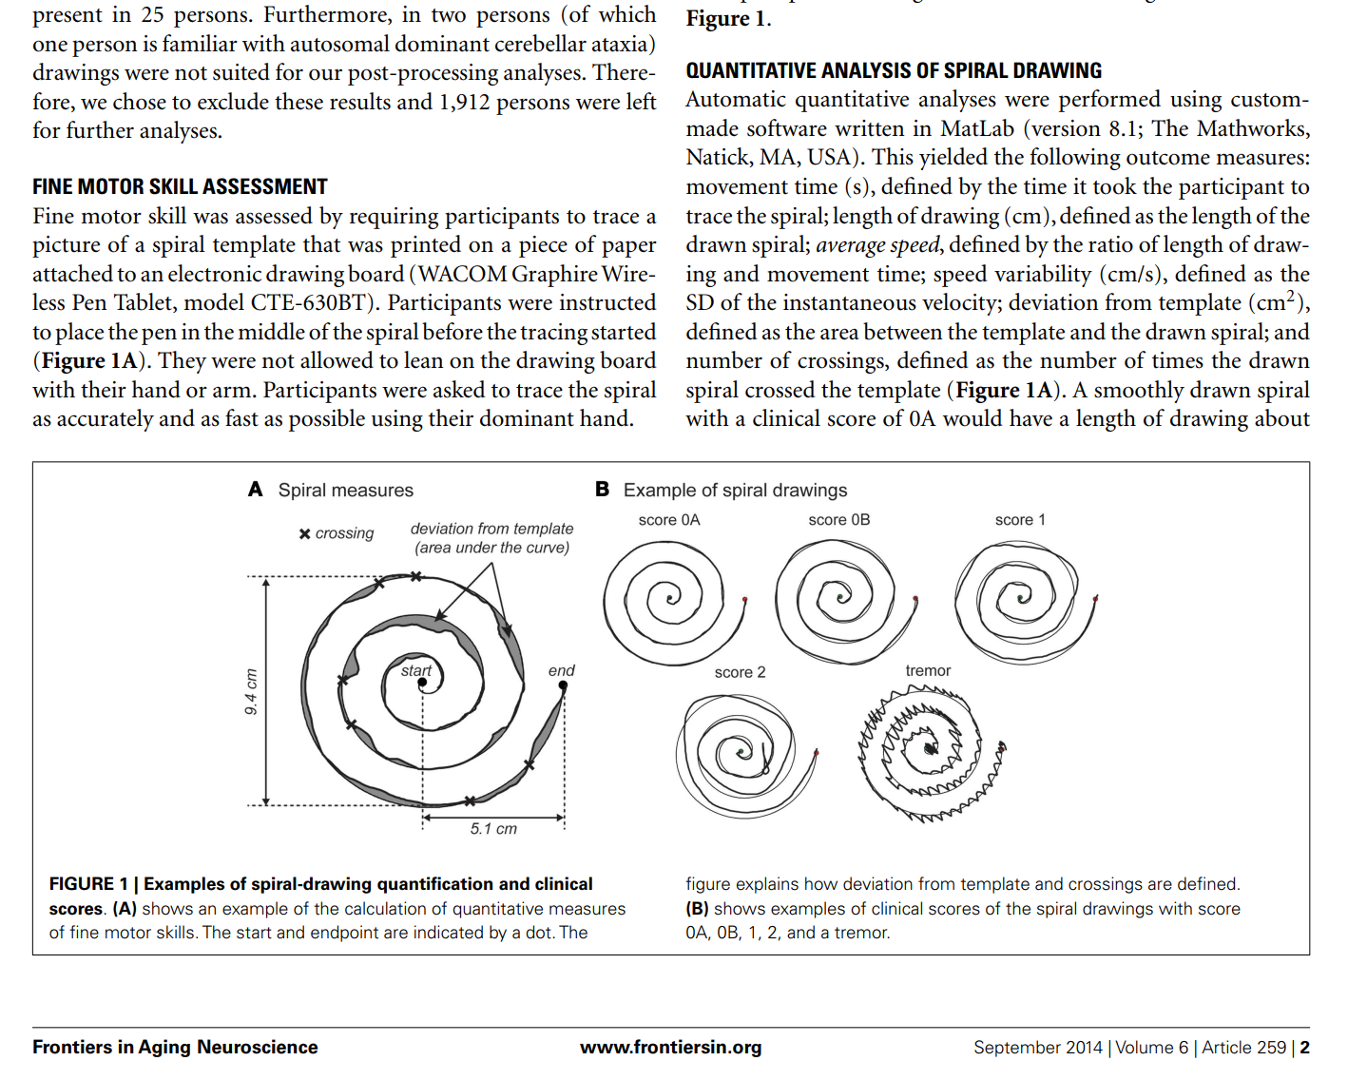
It’s actually a hot topic: From the research papers
Research paper reference:
https://www.ncbi.nlm.nih.gov/pmc/articles/PMC4174769/pdf/fnagi-06-00259.pdf

Slide 6
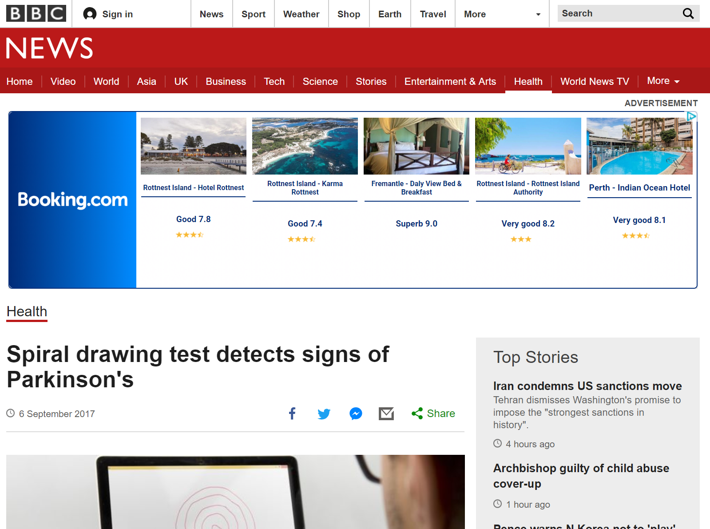
In the media: Use drawing to detect Parkinson’s Disease
News reference from BBC: http://www.bbc.com/news/health-41176738

Slide 7
Drawing patterns and Parkinson Detection
What are the connections between them?

Slide 8
Neurograph, Drawing patterns and Parkinson Detection
Parkinson
Shaking, maybe?
Drawing patterns may be potentially influenced
Or just can’t focus
The drawing pattern may tell us something interesting

Slide 9
By studying drawing patterns, such as
Average Speed
Touching pressure
Drawing Speed changes
Maximum differences in horizontal direction
Number of crossings
Total drawing time
Deviation from the template image

Slide 10
Analyse them statistically,
We could find some drawing characteristics that’s special for Parkinson patients.

Slide 11
Analyse them statistically,
Then we may be able to distinguish between normal people and Parkinson patients.

Slide 12
What this project contains
Two parts
Part 1: An Android app which captures the drawing data
Store the data into different format of data files which can be analysed
Part 2: Analyse the drawing data and study interesting features (Done by Cathy)

Slide 13
Introduction to Android app: Neurograph

Slide 14
The aim of this app
Capture the data
Store the data, and/or send the data

Slide 15

How the users use it? The Procedure
A new user
Who wants to know whether
he is a potential Parkinson patient
Register
Name, age, gender, education level etc should be taken into account
Do the tests

Slide 16
How the users use it? The Procedure
Clinical staff
Output the data by
Sending it via email
Save it locally then connect the device to a PC

Slide 17
How the users use it? The Procedure
Data analyst analyse the data (Cathy)
Then tell whether this user has Parkinson or not
Done using R and matlab,
Sadly android is not good at data analysis

Slide 18
How the users use it? The Procedure
Maybe after a few months of treatment the user wants to come back to do the tests again
He/she can come back using the registration code (Something like an user name, it’s unique for each user)
Do the tests again to see whether the disease condition changes or not

Slide 19
Drawing tests
In this app we have 6 different kinds of tests, some of them are from the research paper which has been used previously and proved to be useful.

Slide 20
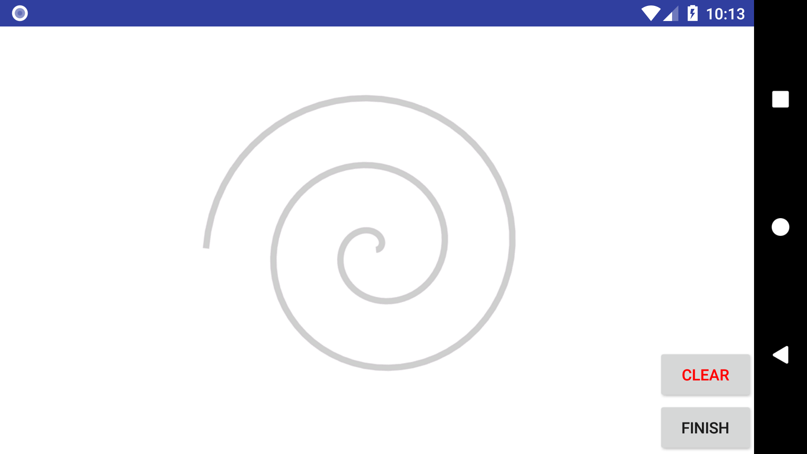
Static Background Test

Slide 21
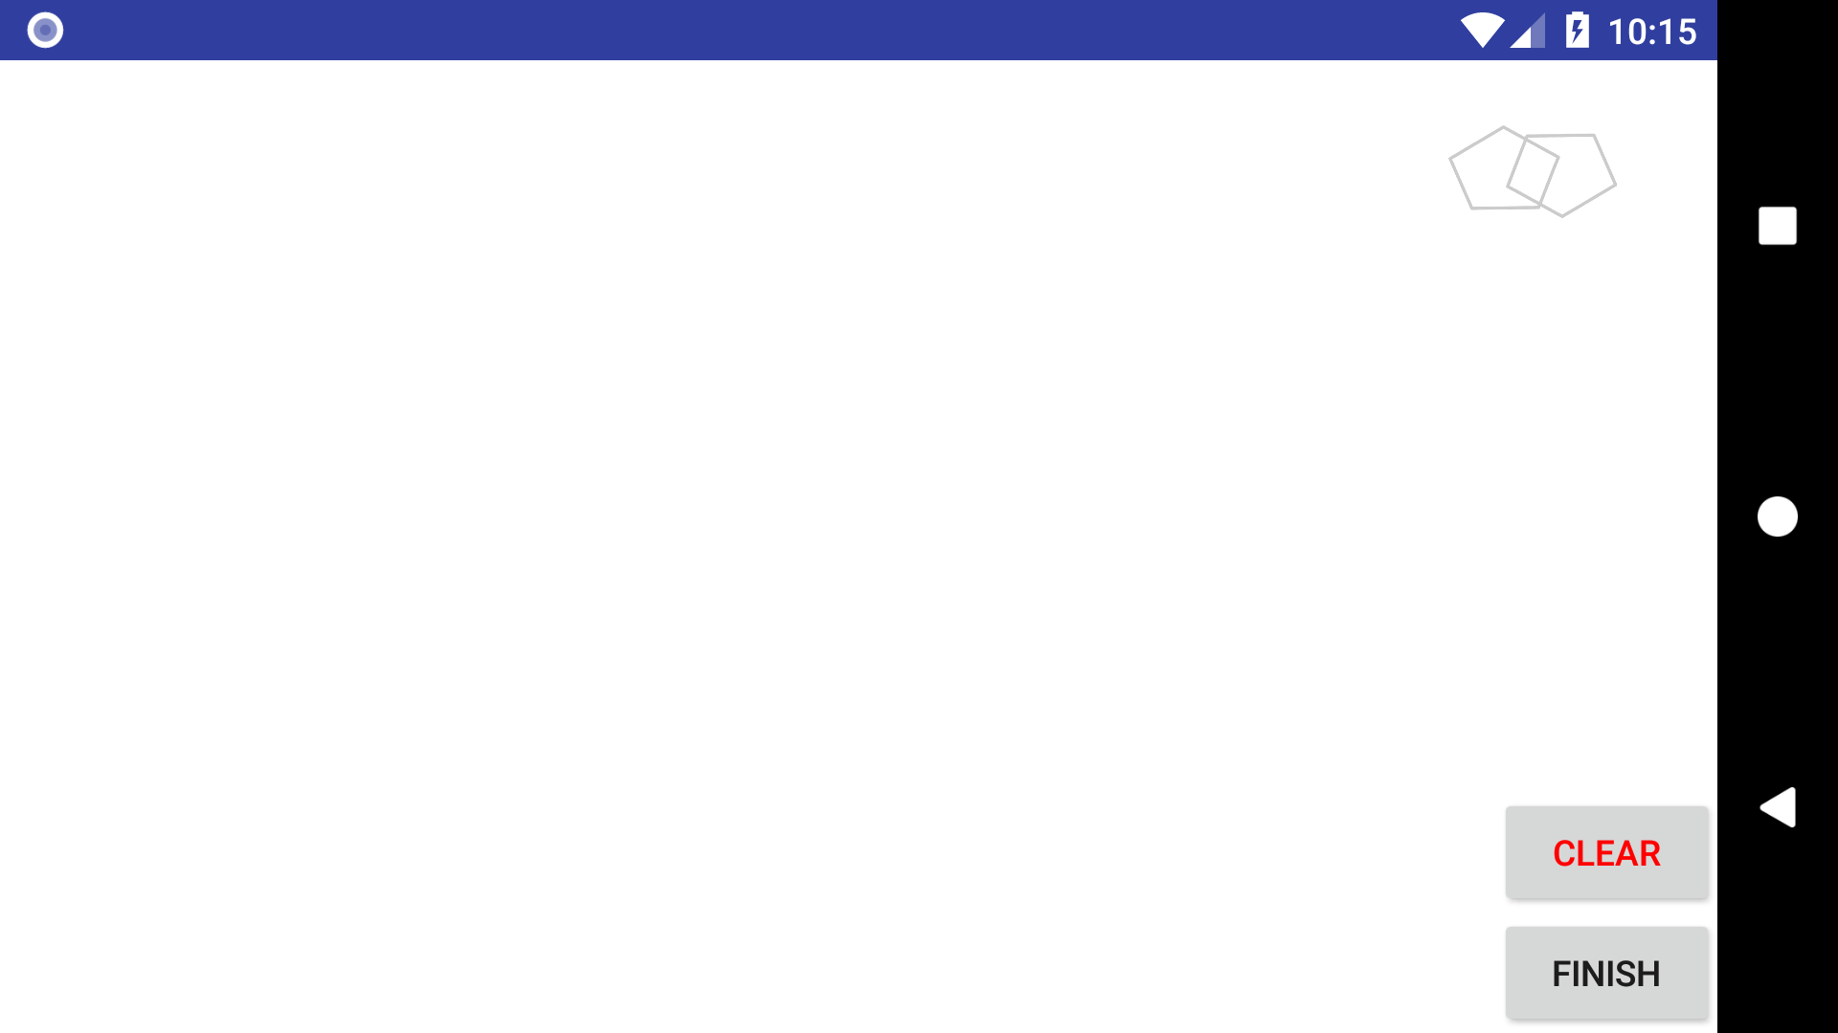
Static Corner Background Test

Slide 22
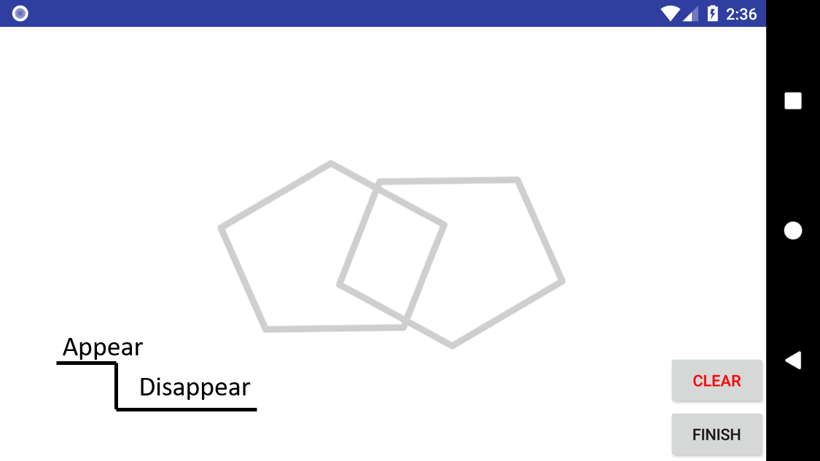
Dynamic Blank Background Test

Slide 23
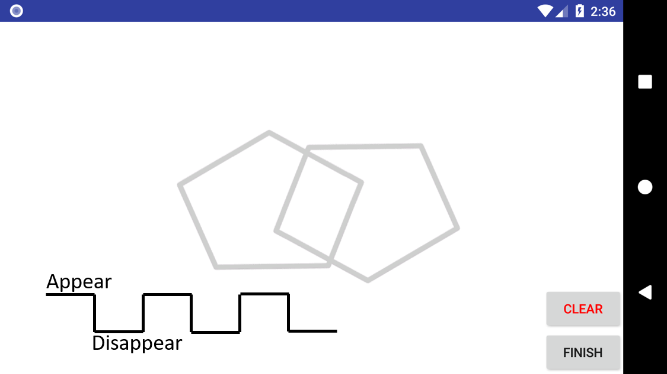
Dynamic Seasonal Background Test

Slide 24

Parallel Line Test

Slide 25
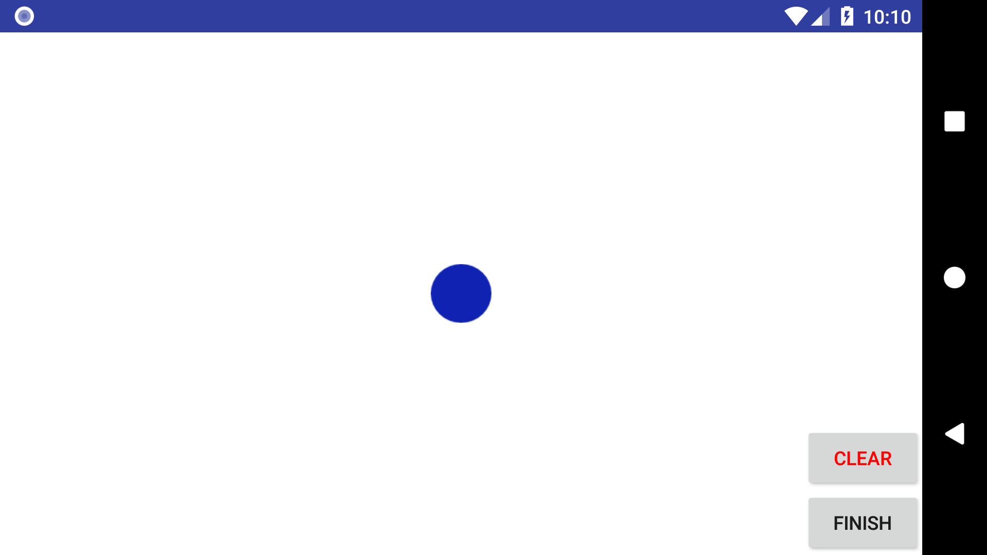
Circular Motion Test

Slide 26
Whether the user can draw the shapes as required helps us make the decision

Slide 27
Every single detail like deviation area or the changes of speed may tell whether this user has Parkinson’s disease or not

Slide 28
Interestingly, android captures dots, not line
In my eye,
In Android’s eye,

Slide 29

Actually, Android is smart enough
It captures a point every 0.02 second approximately
The precision can reach 5 decimal places

Slide 30
So there are enough “details” to help us detect the Parkinson’s Disease

Slide 31
While,
Talk is cheap,
Show me your app…

Slide 32
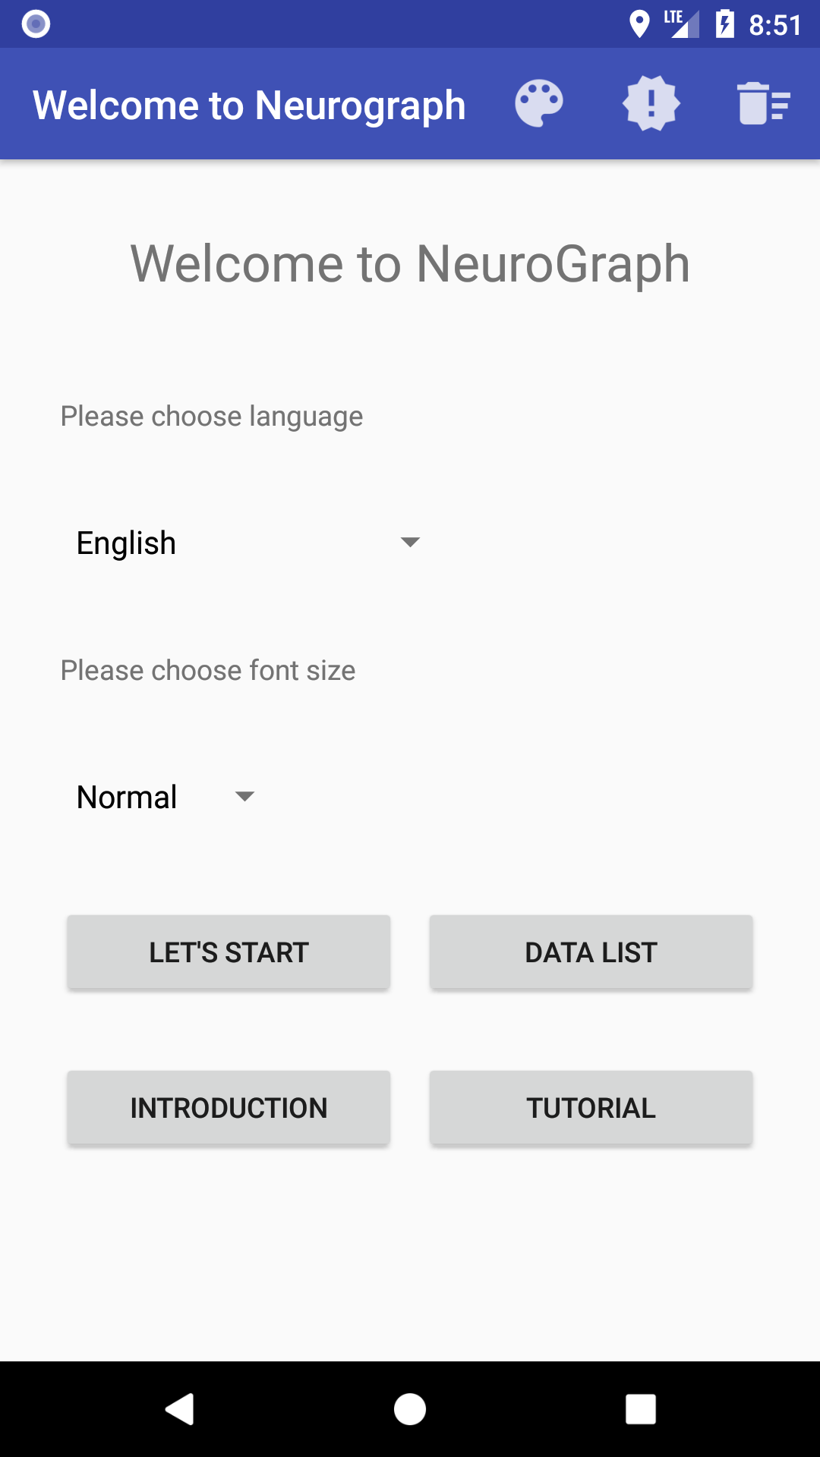
The app: App demonstration
Collect information about the user
The tests
Output the data

Slide 33
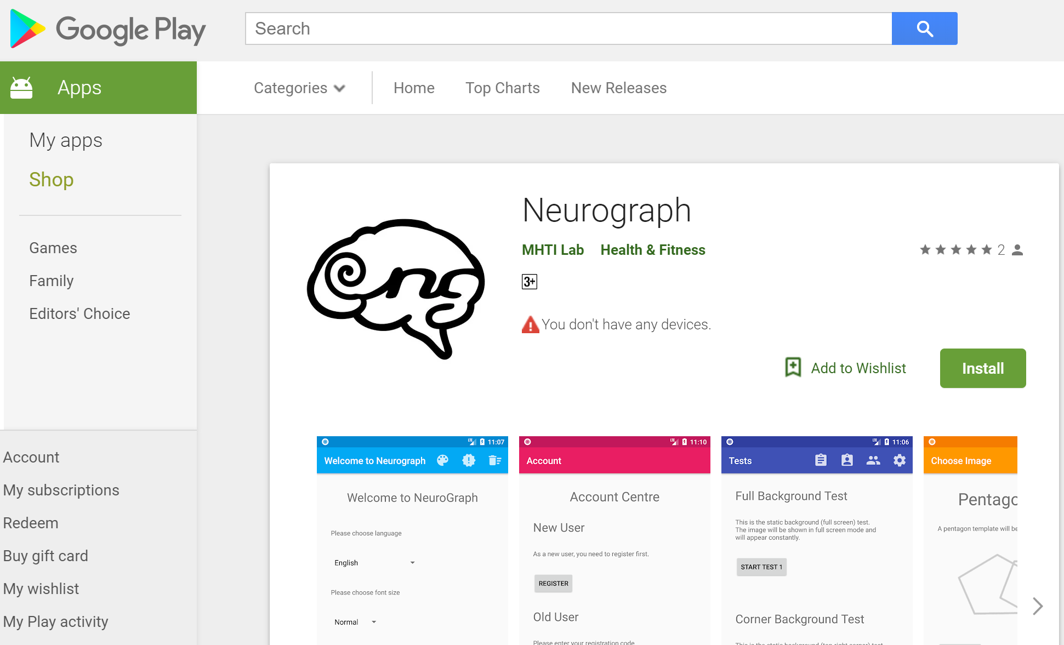
App demonstration
Link to Google Play Store: https://play.google.com/store/apps/details?id=com.neurograph.usydjiashuwu.neurograph

Slide 34
Future TODOs
Identify Signatures

Slide 35
Q & A

Slide 36
Thank you ^_^

